Slide 1

Space Complexity
Instructor: Kuan Cheng

Slide 2
Space Complexity
In contrast to time, space complexity measures the memory cost.
In the TM model, the # of cells a TM M uses for a problem/language (worktape).
Define the function S: N → N s.t. S(n) is the maximum # of cells M uses on the work tapes (excluding the input tape) for any input of length n.
Say M runs in space S(n)

Slide 3
Space Complexity
Say a language L ∈ SPACE (S(n)) if there is a TM M deciding L and M uses space O(S(n)).
Similarly, say a language L ∈ NSPACE (S(n)) if there is a NDTM M deciding L and M uses space O(S(n))
every branch halts and uses space O(S(n))).
Typically, require the function S to be space-constructible, i.e., S(n) can be computed in space O(S(n)).

Slide 4
Space Complexity
Since work tapes are separated from input tapes, it makes sense to consider S(n)< n.
In contrast to time complexity where we generally require T(n)≥n.
However, require S(n)≥log n so that the TM can at least remember the index of the input cell.

Slide 5
Relation to Time Complexity
DTIME(S(n)) ⊆ SPACE(S(n))? Why?
A TM can only access constant number of cells per step.
However, a space S(n) TM can run much longer than S(n) steps, e.g., count from 1 to 2^{S(n)} -1 (space can be reused).

Slide 6
Relation to Time Complexity
Last subseteq, the only known way to simulate space bounded TMs by time bounded TMs.
Any improvement would be a major result.

Slide 7
Configuration Graph
Let M be a DTM or NDTM.
Recall the configuration of a TM: state, head positions, all tape contents.
Tapes are unbounded, but we can ignore the blank entries of the tapes.
For a space S(n) TM, there are at most S(n) non-blank work tape entries.

Slide 8
Configuration Graph

Slide 9
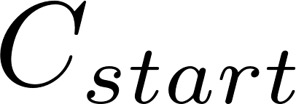
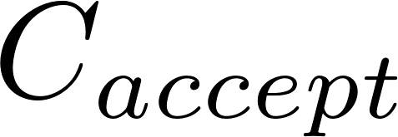
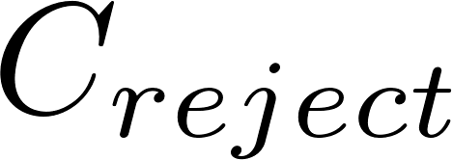
。。。。。。
。。。
。。。
。。。

Slide 10
Configuration Graph

Slide 11
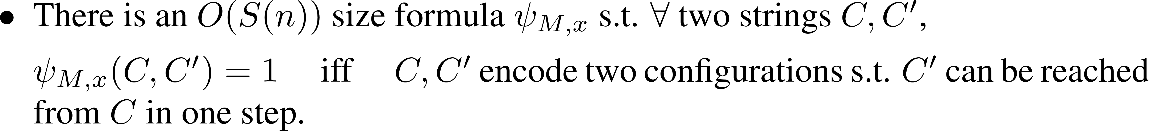
Configuration Graph

Slide 12
Configuration Graph

Slide 13
Configuration Graph
Proof of the claim:
1) A configuration is completely decided by the state, head positions and non black entries of the tapes.
Encode each one of them and combine together, total size O(S(n)).
2) Same idea as in the proof of Cook-Levin:
express one step of computation as the AND of many small checks, each of size O(1). The # of checks is O(S(n)).

Slide 14
Proof of the Theorem

Slide 15
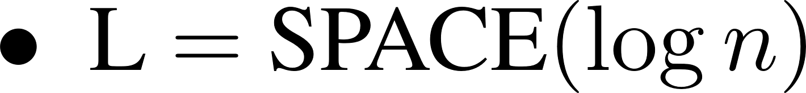
Space Complexity Classes

Slide 16
Space Complexity Classes

Slide 17
More Examples
EVEN={x: x has an even # of 1’s}
MULT={ ( a, b, ab ) }.
Both languages are in the class L (can be solved in logspace).
Seems hard to conceive more complicated problems that can be solved in logspace,
however, cannot even rule out SAT ∈ L (i.e., not known if NP≠L).

Slide 18
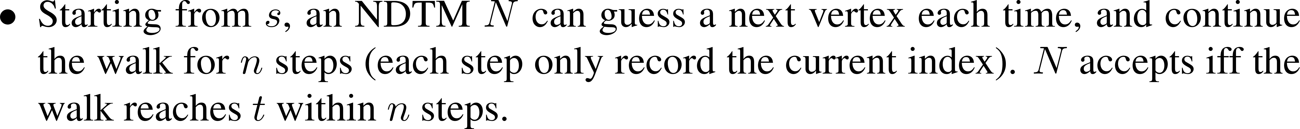
More Examples

Slide 19
More Examples

